Slide 1

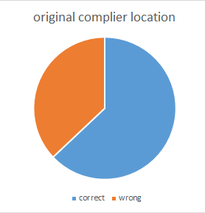
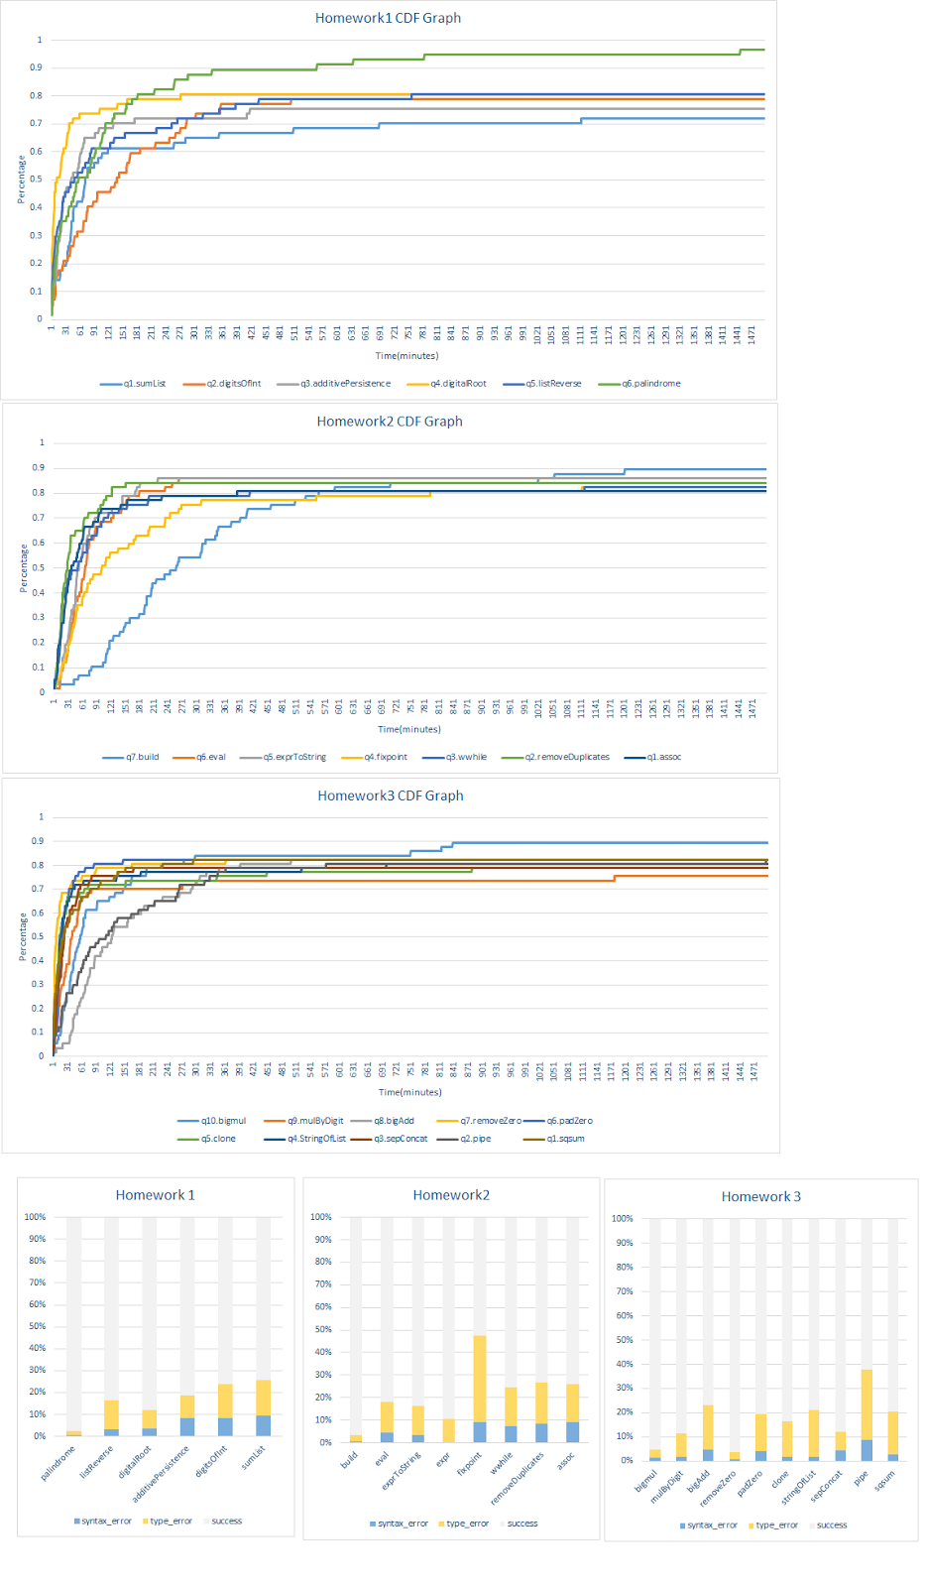
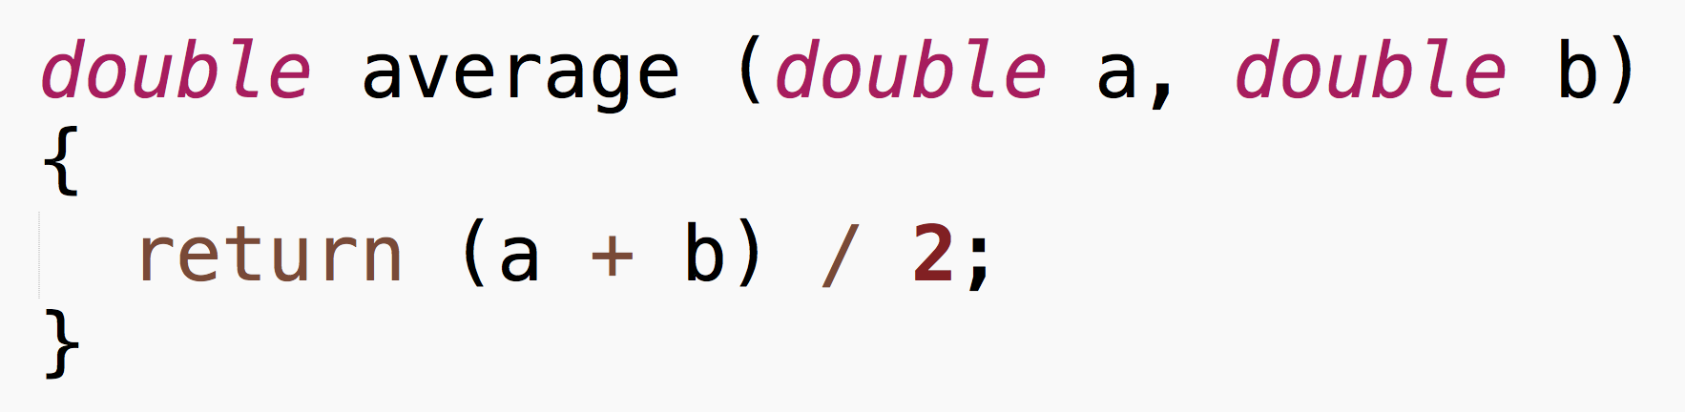
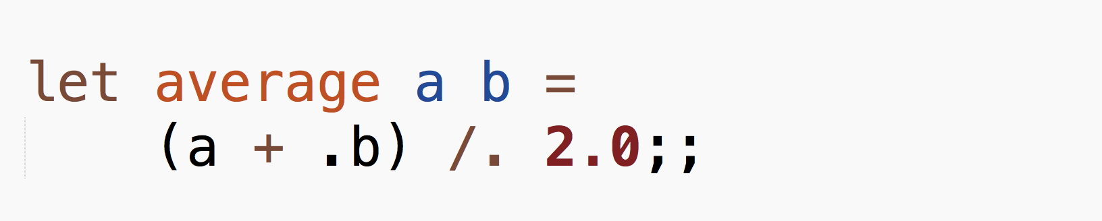

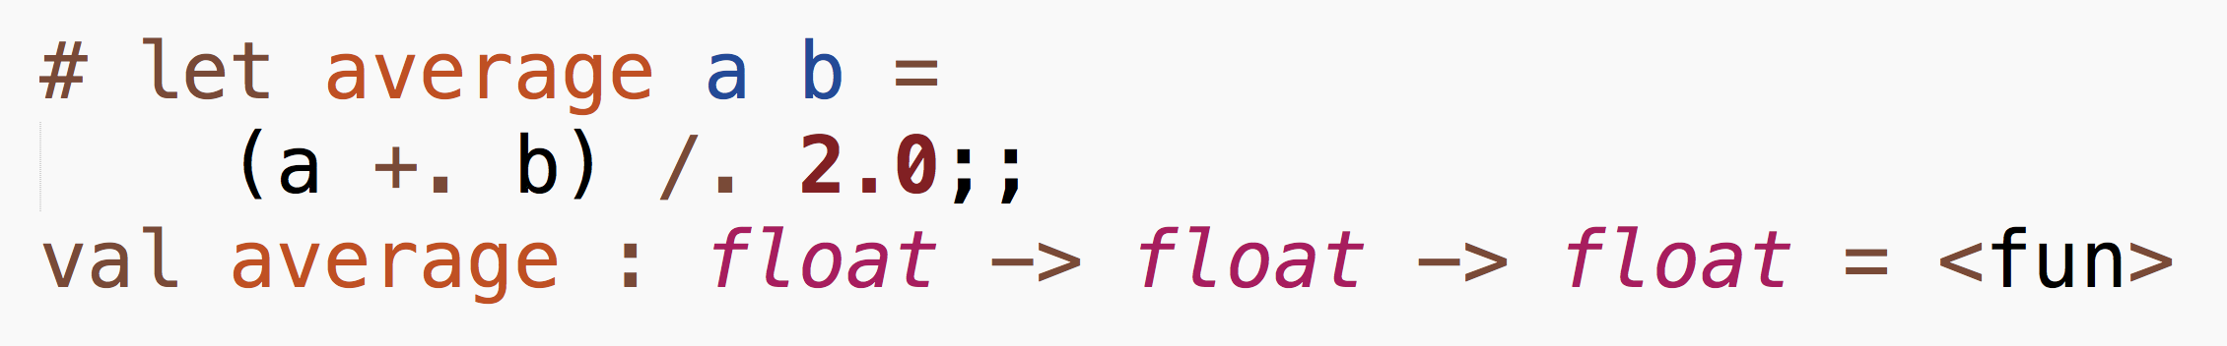
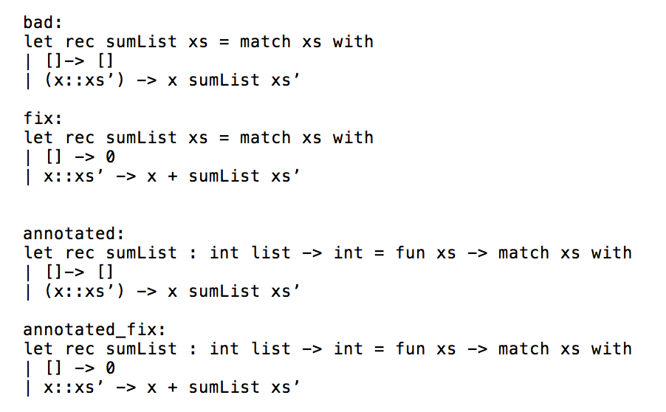
Type Inference from Test Cases
Jiani Huang, Soomin Lee, Yijun Zhang
UCSD CSE Early Research Scholars Program (ERSP)
Problem Statement
Data Analysis
Methods
Results
It is well-known in community that functional programming languages are challenging, but less is understood about why. Our goal is to understand how beginners learn OCaml and propose a way to make their learning process more efficient
Initial data analysis was done to see how much time the students spend on each homework problem to find out which concepts they struggle with the most.
We proceeded to see if the actual fixed location matches the error location that compiler outputs and found that the error messages are largely misleading.
Background
In order to improve error messages, we decided to use OCaml’s type annotation.
From top-level, typing an OCaml function generates its type annotation. It prints out what it thinks are the types of declared function. The general format is:
Syntax difference - Java vs. OCaml:
Time taken to complete a method vs. Percentage of students
Above code snippets show the same function to calculate the average between two numbers – they differ in keywords as well as syntax which could cause confusion to beginners when they first learn OCaml
From our collected data, we were able to find out that type errors were the most challenging form of compiler output for beginners:
For example,
In order to track students’ progress, we collected data from homework assignments from CSE 130, which included snapshots of their entire file every thirty seconds. Collected as JSON files, they included the following:
Unix timestamp
Body of file
Section of code that was send to compiler
Output error message, if any
And we used this information to annotate each function and its fixed version, to see if this would lead to OCaml compiler outputting more accurate error location:
References
After looking at type errors, in order to see how the student’s code changes over time, we tracked the progress of each function, and labeled them as bad/fix pairs:
Tutorials & FAQ Retrieved from ocaml.org
Acknowledgements
We would like to thank
This material is based upon work supported by the National Science Foundation under Grant No. CNS-1339335.

